Slide 1
Greek mythology

Slide 3
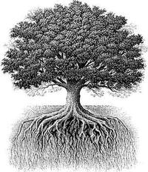
Parents of Zeus:
King of the Gods
Cronus and Rhea
Symbol(s) Of Zeus:
Thunderbolt, eagle and oak tree
Spouse(s):
Metis, Themis, Hera

Slide 4
Poseidon
God of the Sea
Parents of Poseidon:
Symbol(s) Of Poseidon:
Cronus and Rhea
Sea, trident, horse, dolphin
Spouse/Mate(s):
Amphitrite Medusa, Chrysaor, Demeter, Thoosa, Iphimedeia, Tyro, Periboia, Amymone, Pitane, Euryale, Aithra

Slide 5
Parents of Hades:
Cronus and Rhea
Symbol(s) Of Hades:
Pomegranate, cap of invisibility
Spouse/Mate(s):
Hades
God of the Underworld
Persephone, Minthe, Leuce

Slide 6
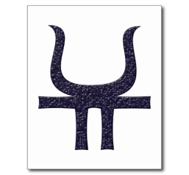
Hestia
Goddess of the Hearth/Home
Parents of Hestia:
Cronus and Rhea
Symbol(s) Of Hestia:
Fireplace
Spouse/Mate(s):
None

Slide 7
Goddess of Marriage
Hera
Parents of Hera:
Cronus and Rhea
Symbol(s) Of Hera:
Peacock, cow, wedding ring
Spouse/Mate(s):
Zeus

Slide 8
Ares
God of war
Parents of Ares:
Zeus and Hera
Symbol(s) Of Ares:
Dog, wild boar, vulture
Spouse/Mate(s):
Aphrodite, Aerope, Agraulos, Althaia, Asterie, Astyokhe, Atalante, Chryse, Cyrene, Demonike, Dotis, Harmonia, Harpina, Ilia, Otrere, Pyrene, Pelopia, Phylonome, Protogeneia, Sterope, Tereine, Telphousia, Triteia,

Slide 9
Athena
Goddess of War/Wisdom
Parents of Athena :
Zeus and Metis
Symbol(s) Of Athena:
Owl, olive, tree, plow, loom
Spouse/Mate(s):
Hephaestus, sort of

Slide 10
Apollo
God of music, Light/The Sun, and Prophecy
Parents of Apollo:
Zeus and Leto
Spouse/Mate(s):
Marpessa, Chione, Koronis, Daphne, Arsinoe, Kassandra, Kyrene, Melia,
Symbol(s) Of Apollo:
Lyre, sun, mice, Laurel tree

Slide 11
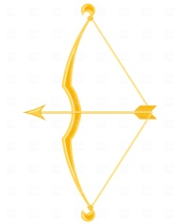
Artemis
Goddess of the Moon/Hunting
Parents of Artemis:
Zeus and Leto
Symbol(s) Of Artemis :
Spouse/Mate(s):
Moon, deer, silver bow and arrows
None

Slide 12
Aphrodite
Goddess of Love/Beauty
Parents of Aphrodite :
Zeus and Dione
Symbol(s) Of Aphrodite:
Dove, swan, roses
Spouse/Mate(s):
Hephastus/Ares, Dionysus, Hermes, Poseidon, Nerites, Anchises, Adonis, Butes, Phaon, Phaethon.

Slide 13
Hermes
Messenger God
Parents of Hermes:
Zeus and Maia
Caduceus, crane
Symbol(s) Of :
Agraulos, Akalle, Antianeira, Alkidameia, Aphrodite, Aptale, Carmentis, Chthonophyle, Creusa, Daeira, Erytheia, Eupolemeia, Khione, Iphthime, Libya, Okyrrhoe, Penelopeia, Phylodameia, Polymele, Rhene, Sose, Theoboula, Thronia,
Spouse/Mate(s):

Slide 14
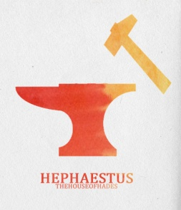
Hephaestus
God of Fire/Forging
Parents of Hephaestus:
Zeus and Hera
Symbol(s) Of Hephaestus:
Spouse/Mate(s):
Hammer, quail
Aglaia or Aphrodite or Charis
Other Mates: Antikleia, Cabeiro, Aetna, Thaleia

Slide 15
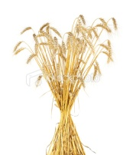
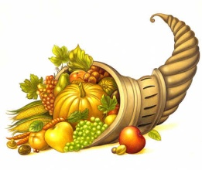
Demeter
Goddess of Harvest, Fertility and Agriculture
Parents of Demeter:
Cronus and Rhea
Symbol(s) Of Demeter:
Ear of wheat and the Horn of Plenty (Cornucopia).
Spouse/Mate(s):
Iason, Zeus, Poseidon

Slide 16
Dionysus
God god of wine, vegetation, pleasure and festivity.
Parents of Dionysus:
Zeus and Semele
Symbol(s) Of Dionysus:
Grape-vine, Leopard.
Spouse/Mate(s):
Many

