Slide 1
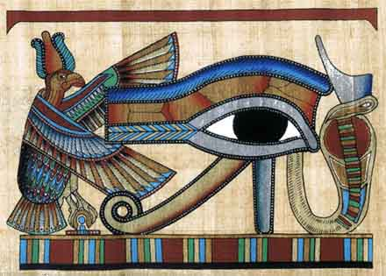
The Gods and Goddesses of Ancient Egypt

Slide 2
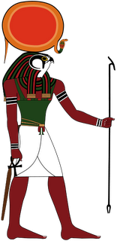
RA
The god of the Sun

Slide 3
Ra was the sun god. He was the most important god of the ancient Egyptians. The ancient Egyptians believed that Ra was swallowed every night by the sky goddess Nut, and was reborn every morning.

Slide 4
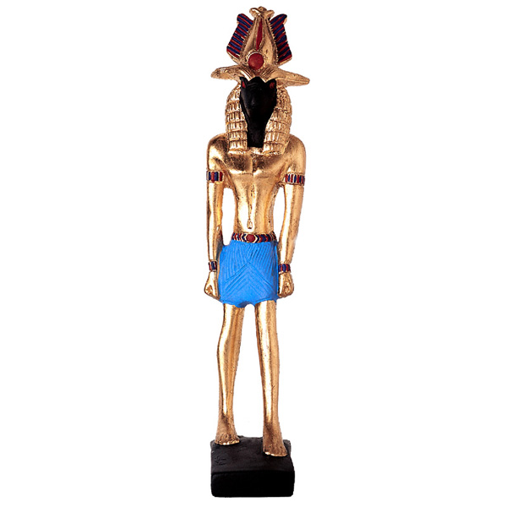
HAPI
The god of the Nile

Slide 5
Hapi was a very important deity to anyone living in the Nile valley. He was the god of the Nile, particularly the inundation (flooding). It was believed that Hapi's source was two whirlpools in the caves on Elephantine island. On his journey he was thought to flow through the Underworld, through the heavens, and then through Egypt. He was responsible for watering the meadows and bringing the dew. But most importantly he brought the fertile inundation. He provided food and water for nourishment and for offerings to the gods.

Slide 6
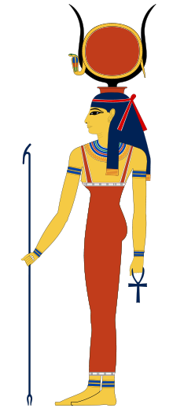
HATHOR
The goddess of Women, Childbirth and Children

Slide 7
A powerful and complex goddess with numerous attributes. Hathor was the protector of women, whom she assisted in conception and childbirth. As the guardian of children she restored the young god Horus’sight after the god Set tore out his eyes. She was also the protector of lovers. Hathor was associated with death and rebirth. She greeted the souls of the dead in the underworld and offered them refreshments of food and drink.

Slide 8
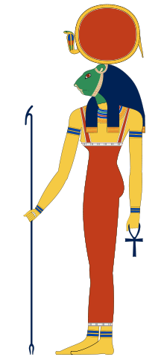
SEKHMET
The goddess of War

Slide 9
She was the goddess of war. A lioness goddess, worshiped in Memphis as the wife of Ptah; created by Ra from the fire of his eyes as a creature of vengeance to punish mortals for their sins; later, was transformed into a peaceful goddess of pleasure and happiness, Hathor.

Slide 10
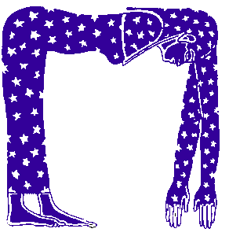
NUT
The goddess of the Sky

Slide 11
Nut was the sky-goddess, whose body created a vault or canopy over the earth. Nut was the sister/wife of Geb, the god of the earth. She was also the mother of Isis, Osiris, Nephthys and Set. The ancient Egyptians believed that at the end of the day, Nut swallowed the sun-god Ra, and gave birth to him again the next morning.

Slide 12
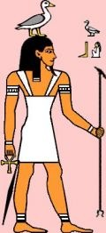
GEB
The god of the Earth

Slide 13
The god of the Earth, the offspring of Shu, the god of air, and Tefenet the goddess of wetness and water.

Slide 14
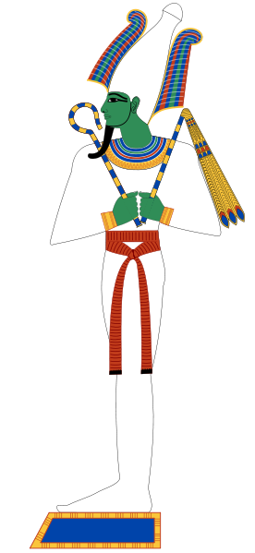
OSIRIS
The god of the Dead

Slide 15
Osiris was the god of the dead, and ruler of the underworld. Osiris was the brother/husband of Isis, and the brother of Nepthys and Set. He was also the father of Horus. As well as being a god of the dead, Osiris was a god of resurrection and fertility. In fact, the ancient Egyptians believed that Osiris gave them the gift of barley, one of their most important crops. A large temple was built to honor Osiris at Abydos. Osiris ruled the world of men in the beginning, after Ra had abandoned the world to rule the skies, but he was murdered by his brother Set. Through the magic of Isis, he was made to live again. Being the first person to die, he subsequently became lord of the dead. His death was avenged by his son Horus, who defeated Set and cast him out into the desert to the West of Egypt (the Sahara).

Slide 16
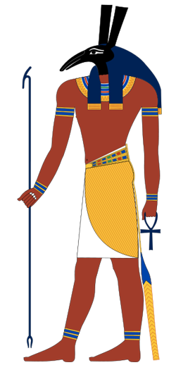
SET/SETH
The god of Chaos

Slide 17
He was the god of chaos. Set represented everything that threatened harmony in Egypt. He was the brother of Osiris and Isis, as well as the brother/husband of Nephthys. He murdered his brother Osiris, then battled with his nephew Horus to be the ruler of the living. At certain times in the history of ancient Egypt, Set was associated with royalty. In earliest times, Set was the patron deity of Lower (Northern) Egypt, and represented the fierce storms of the desert whom the Lower Egyptians sought to appease. However, when Upper Egypt conquered Lower Egypt and ushered in the 1st Dynasty, Set became known as the evil enemy of Horus (Upper Egypt's dynastic god).

Slide 18
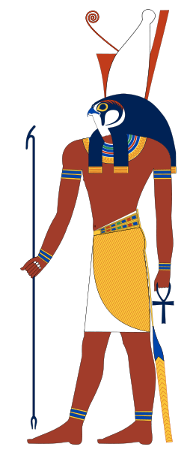
HORUS
The god of Sky

Slide 19
The falcon-headed god, the son of the goddess Isis and the god Osiris. Set caused the death of his brother Osiris, the first king of Egypt, and seized his throne. Isis retrieved her husband's body and hovered over it in the form of a sparrowhawk, fanning enough life back into him for her to conceive a son, Horus. She knew Set would harm her child, so she fled the Nile delta and gave birth to Horus at Chemmis near Buto. With the assistance of other deities, such as the goddesses Hathor, Selquet, Isis raised Horus until he was old enough to challenge Set and claim his royal inheritance. The sun god invited Horus and Set to put their cases before the Ennead. Set declared that he should be king because only he was strong enough to defend the sun during its nightly voyage through the underworld.

Slide 20
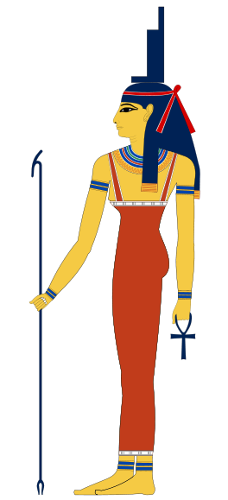
ISIS
The goddess of Wives and Mothers

Slide 21
A great goddess, the wife and sister of Osiris, the sister of Seth and Nephthys, and the mother of Horus. Isis, one of the nine great deities known as the Ennead, is featured in myth principally as the devoted wife of Osiris, the first king on earth, and the mother of Horus. As the divine exemplar of the dedicated wife and mother, Isis was the center of an important cult which spread over, and out of, the borders of ancient Egypt. The goddess's adversary was her brother Set, who brought about the death of Osiris and stole his throne. Isis retrieved her husband's corpse and protected it from Set, using magic powers to halt or reverse the decay. In one account, Isis hovered over the body as a sparrowhawk and fanned enought life into Osiris with her wings to enable her to conceive a son, the god Horus. Isis protected Horus from Set and assisted him to regain his. birthright, the Egyptian kingship, from his uncle

Slide 22
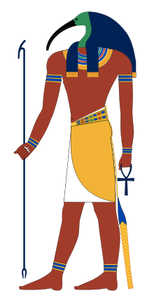
THOTH
The god of Knowledge and Writing

Slide 23
He was the god of writing and knowledge. The ancient Egyptians believed that Thoth gave them the gift of hieroglyphic writing. Thoth was also connected with the moon. The god of wisdom, Thoth was said to be self-created at the beginning of time, along with his consort Maat ((truth), or perhaps created by Re. Thoth was depicted as a man with the head of an ibis, and carried a pen and scrolls upon which he recorded all things. He was shown as attendant in almost all major scene involving the gods, but especially at the judgment of the deceased. He served as the messenger of the gods, and was thus equated by the Greeks with Hermes.

Slide 24
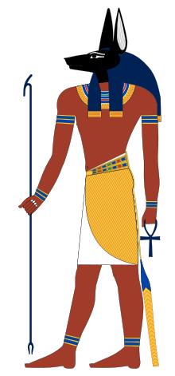
ANUBIS
The god of Embalming

Slide 25
The jackal-headed god of embalming, also known as Anpu. He is sometimes said to be the son of the god Osiris, the first king or pharaoh on earth, and his sister Nephthys. After Osiris was killed by his brother Set, Anubis enbalmed the body and wrapped it in linen bandages making Osiris the first mummy. Anubis later defended the corpse against the attacks of Set. After death Osiris became ruler of the underworld. Anubis, as one of the most important officials, guided the deceased through the underworld into the presence of Osiris and oversaw their judgment.

Slide 26
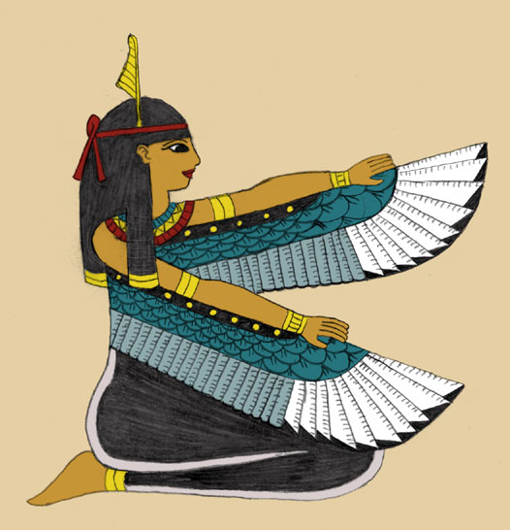
MA’AT
The goddess of Truth and Justice

Slide 27
The goddess of truth and justice. Maat, the daughter of the sun god and wife of Thoth, embodied divine order and harmony. She was depicted standing or squatting, with her symbol, an ostrich feather, in her headdress. In the underworld, the heart - or the conscience - of a dead person was weighed against the feather of Maat; or Truth. If the heart was burdened by sin so that it was heavier than the feather, the deceased was devoured by a monster. If the scales balanced, the deceased became a spirit among the gods.

Slide 28
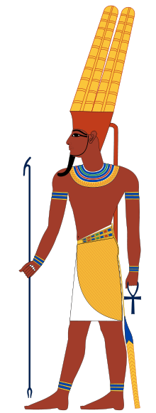
AMUN
The god of

Slide 29
Amun was one of the most powerful gods in ancient Egypt.
Amun was important throughout the history of ancient Egypt. However, when Amun was combined with the sun god Ra he was even more powerful. He was then called Amun-Ra.

Slide 30
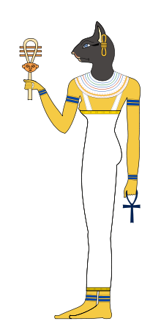
BASTET
The goddess of Love and Fertility

Slide 31
The Cat-headed goddess of love, and fertility. Like the ferocious war goddess Sekhmet, Bastet was originally a lioness deity, but from c. 900 BC, she begain to be represented as a cat, perhaps because of her gentler nature. She was sometimes depicted with kittens, which symbolized her role as a fertility deity. Mummified cats were often buried near her shrines.

